Slide 1

GEARS
Speeeeeeed it up….........

Slide 2
Let’s drive faster with the help of gears
Before building the next models, let’s count a bit.
40/20 = 2
60/20 = 3

Slide 3

Our gears 20 40 60

Slide 4
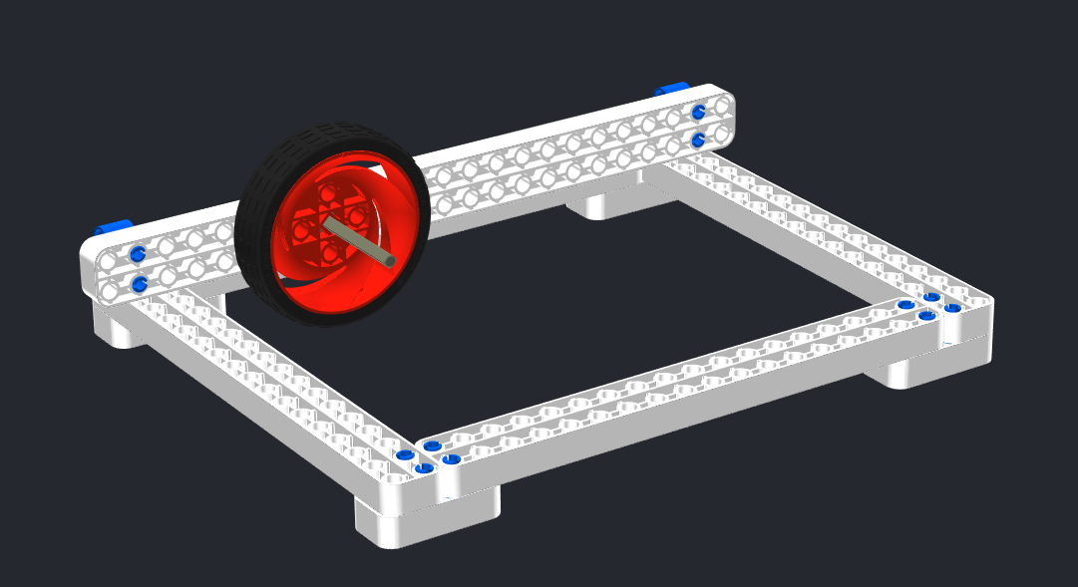
The wheel moves on its own.

Slide 5
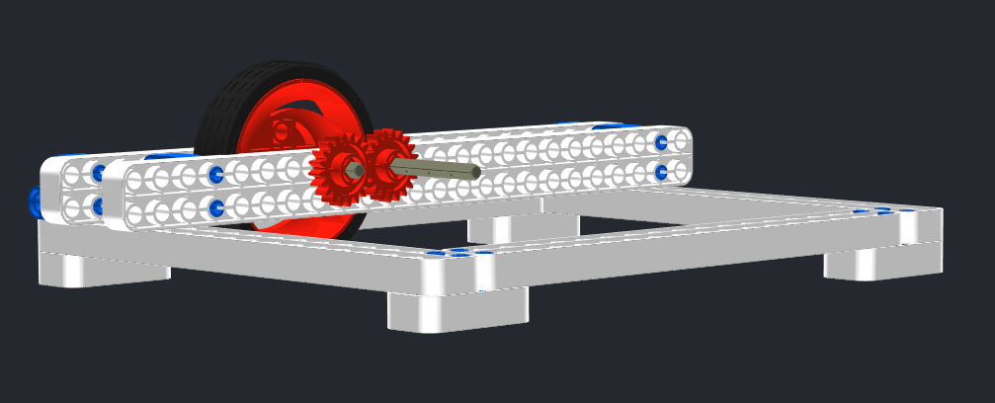
Let’s use two 20-teeth-gears to move the wheel

Slide 6
When we use the same size of gears, they don’t change the speed of the wheel

Slide 7
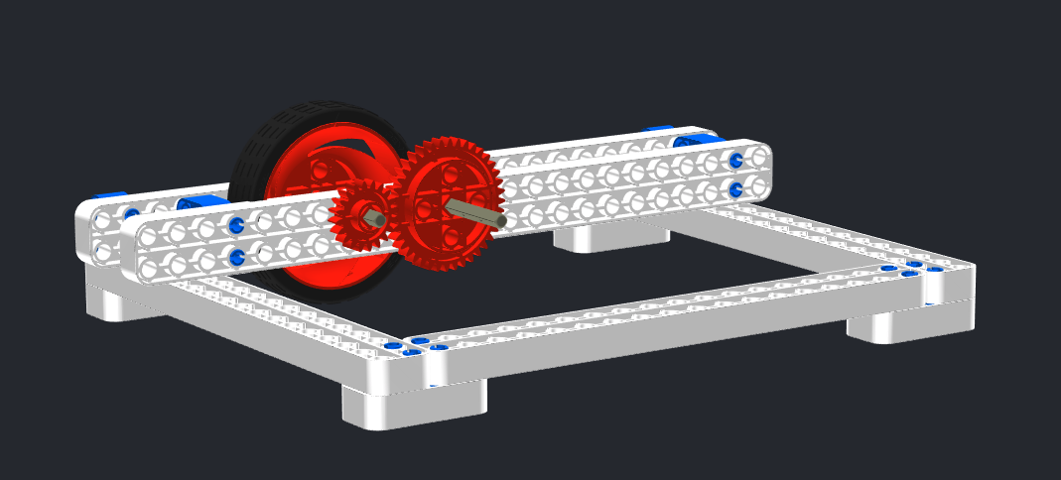
Now let’s swap the drive gear to a 40-teeth-gear

Slide 8
20-teeth-gear with a 40-teeth-gear = 2 x 20 teeth

Slide 9
If the drive gear is two times bigger than the follow gear, it will double its speed, so the wheel will run twice as fast.
40/20 = 2 → 2 x v

Slide 10
Now let’s drive even faster!

Slide 11
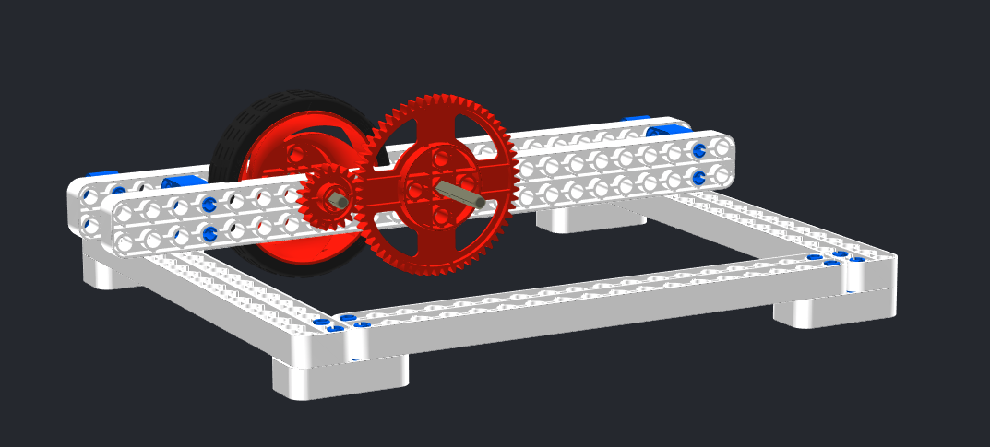
For this model, we swap the 40-teeth-gear to a 60-teeth-one

Slide 12
20-teeth-gear with a 60-teeth-gear = 3 x 20 teeth

Slide 13
If the drive gear is three times bigger than the follow gear, it will triple its speed, so the wheel will run three times faster.
60/20 = 3 → 3 x v

Slide 14
You’ve got this!
How fast will the wheel move if we attach a 60-teeth gear (drive gear) to a 40-teeth-gear (follow gear)?

Slide 15
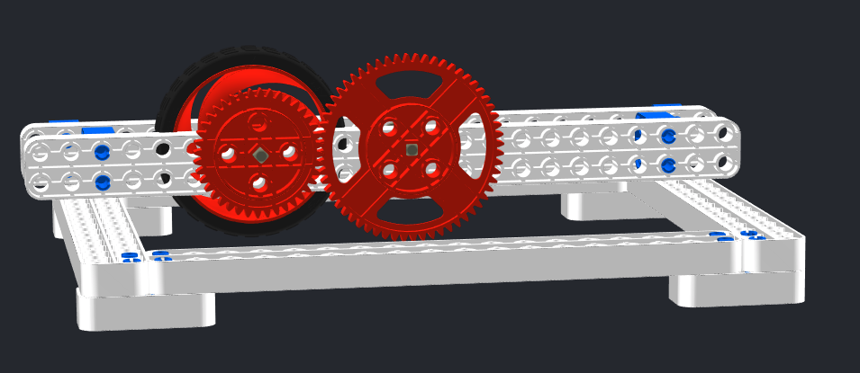
Answer – it will run 1,5 times faster

Slide 16

Good job!!!

